Slide 1

Detecting Deep Fake Faces
By: Rahul torlapati
Data 606
https://github.com/rahultorlapati/DATA606

Slide 2
background
“Deep Fakes” is a popular image synthesis technique based on artificial intelligence.
The goal of “Deep Fakes” is to capture common characteristics from a collection of existed images and to figure out a way of enduing other images with those characteristics, e.g. shapes and styles.
Generative adversarial networks (GANs) is the one of most frequently used ways to implement a “Deep Fake”.

Slide 3
Celeb A
Data set Name – CelebA
Source – Liu, Ziwei and Luo, Ping and Wang, Xiaogang and Tang, Xiaoou, (December 2015) - Deep Learning Face Attributes in the Wild, Proceedings of International Conference on Computer Vision (ICCV)
Link - http://mmlab.ie.cuhk.edu.hk/projects/CelebA.html
Format Type – Image
10,177 number of identities,
202,599 number of face images
5 landmark locations, 40 binary attributes

Slide 4
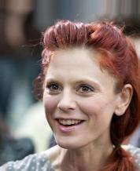
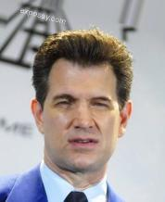
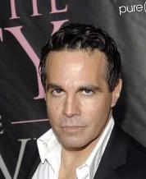
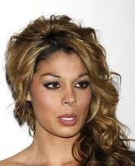

Slide 5
Fake Faces Data Set
Data set Name – 1 Million Fake Faces
Source – Alexander Reben
Images are generated using NVIDIA's StyleGAN and released them under the same CC BY-NC 4.0 license
Link - https://archive.org/details/1mFakeFaces
Format Type - Image
Number of Instances – 1,000,000

Slide 6

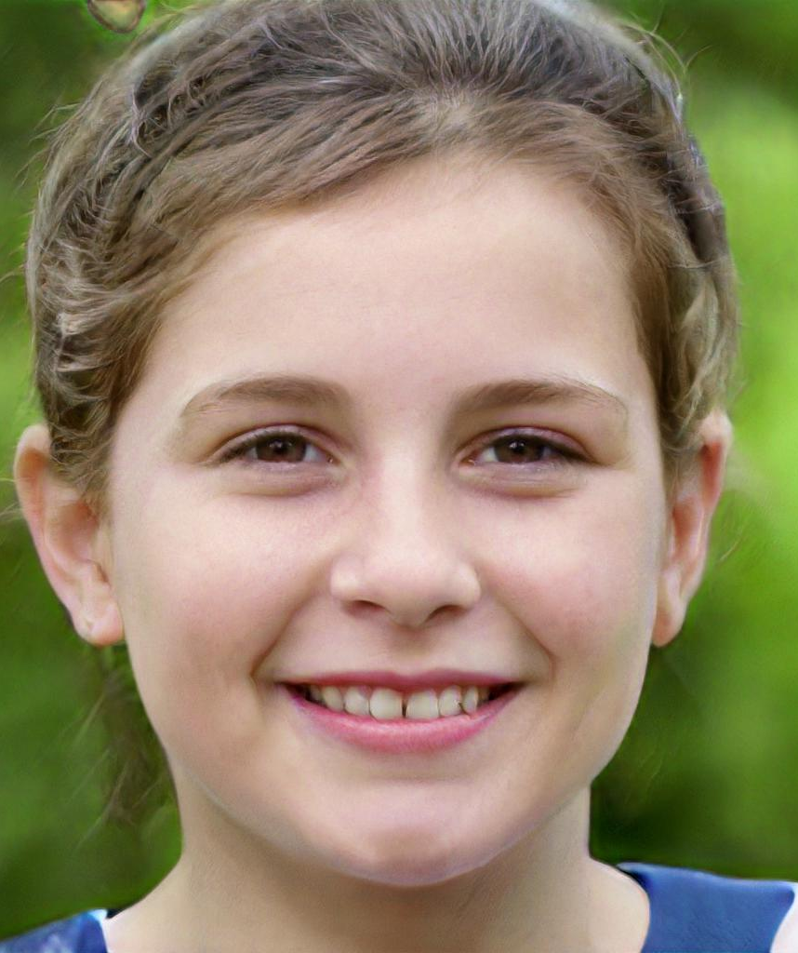



Slide 7
Goal
Train a Neural Network to Detect facial features, Gender, Age group and other attributes from the CelebA dataset images
Test on fake faces determine whether the image belongs to a real person or not

